Slide 1







FRONTEND ENGINEERING - I I
PROJECT
PROJECT NAME:
Group Details:
Group - 3
Jinny Kapur (2210990462)
Jiya Gaba (22109904664)
Kashika (2210990493)
Jashanjit Kaur (2210990440)
Supervised by:
Dr. Baljeet Kaur
Mr. Vikas Patel

Slide 2


TABLE OF CONTENTS
1
INTRODUCTION
2
PROBLEM STATEMENT
3
TECHNICAL DETAILS
4
KEY FEATURES
5
PROJECT HIGHLIGHTS
6
CONCLUSION
7
REFERENCES / LINKS USED

Slide 3
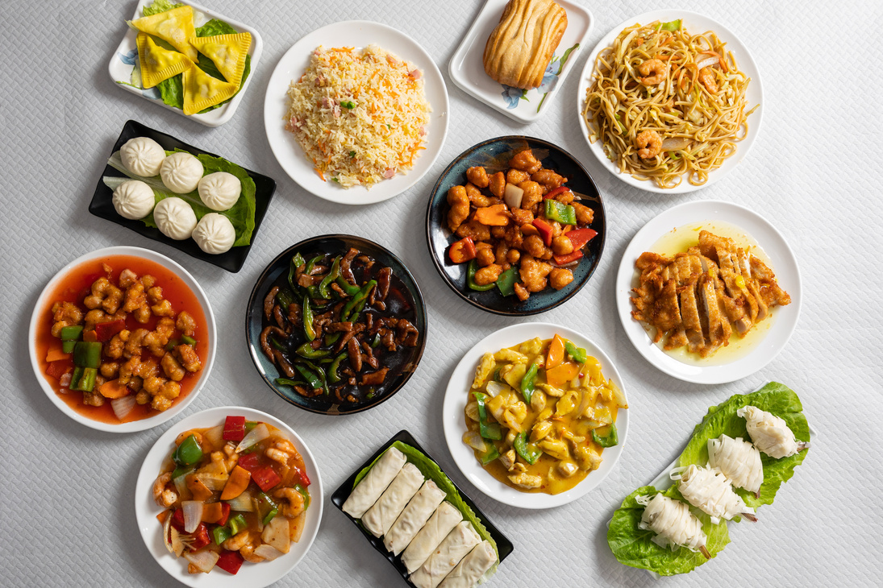
INTRODUCTION
Our project “Forkify Recipes” aims to offer a seamless and user-friendly platform where users can explore a wide variety of dishes from different cuisines.
This project is built using ReactJS, a powerful JavaScript library for building user interfaces, and leverages API fetching to dynamically retrieve and display a vast collection of recipes.
Read More

Slide 4


PROBLEM
STATEMENT
In today's digital age, food enthusiasts and home cooks are constantly seeking new recipes and culinary inspiration from diverse cuisines.
However, finding a comprehensive and reliable source of recipes that offers detailed nutritional information, ingredients, preparation instructions can be challenging.
Existing platforms often lack an intuitive interface and seamless integration of detailed recipe information, which can hinder the user experience and limit culinary exploration.

Slide 5





TECHNICAL
DETAILS
The Forkify is organized using a modular structure facilitated by React.js. The primary components and features include:
React JS
React Router
Tailwind CSS
API

Slide 6

KEY FEATURES
React JS : Scalable, maintainable, and responsive UI.
Real-Time Data: Fetches latest recipes via external APIs.
Tailwind CSS: Consistent, responsive design.
Responsiveness : Seamless experience on all devices.
Detailed Recipes: Includes ingredients, calorie count, and steps.
Intuitive Design: Easy navigation and recipe discovery.
Interactive: Clickable recipe cards and dynamic search.

Slide 7

PROJECT HIGHLIGHTS
Home Page

Slide 8
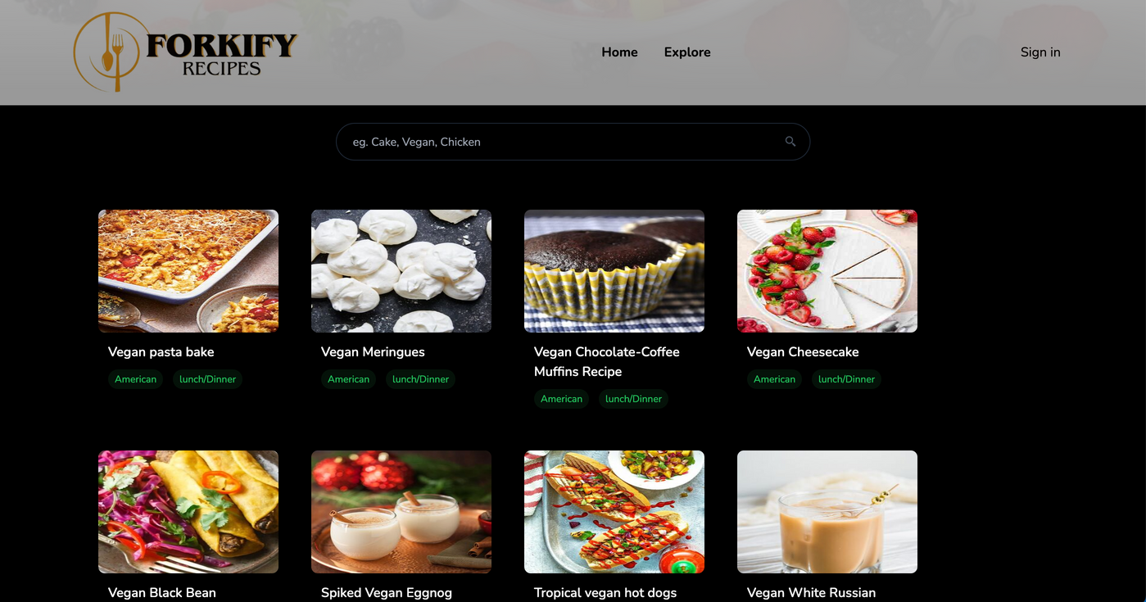


PROJECT HIGHLIGHTS
Search Bar

Slide 9
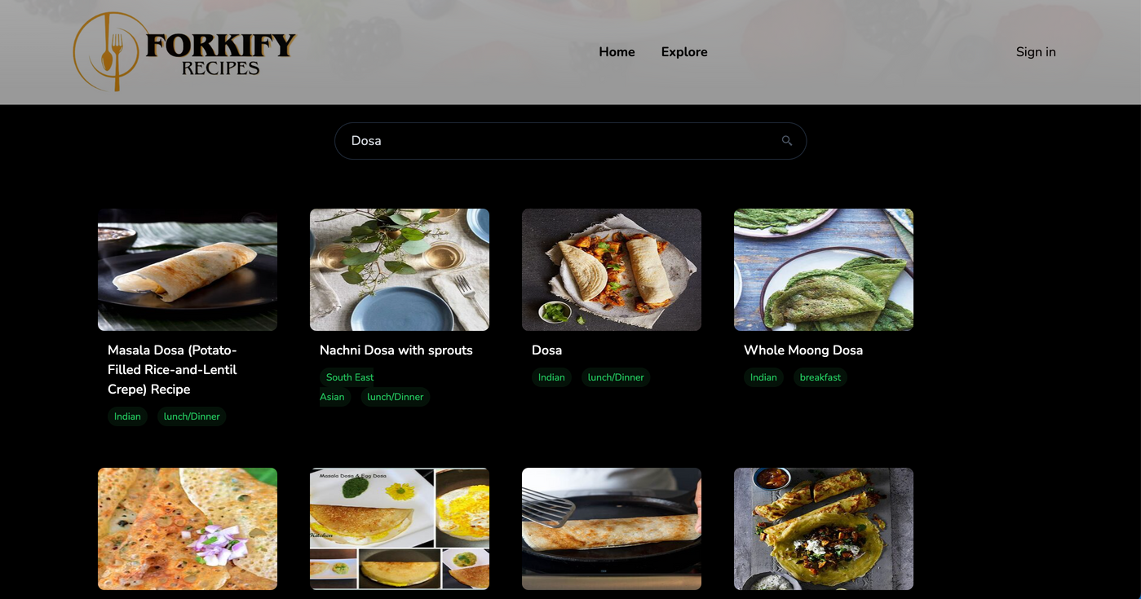
PROJECT HIGHLIGHTS
API Fetching

Slide 10

PROJECT HIGHLIGHTS
Choosing one recipe of our choice
Calories, time taken to cook and servings are shown

Slide 11
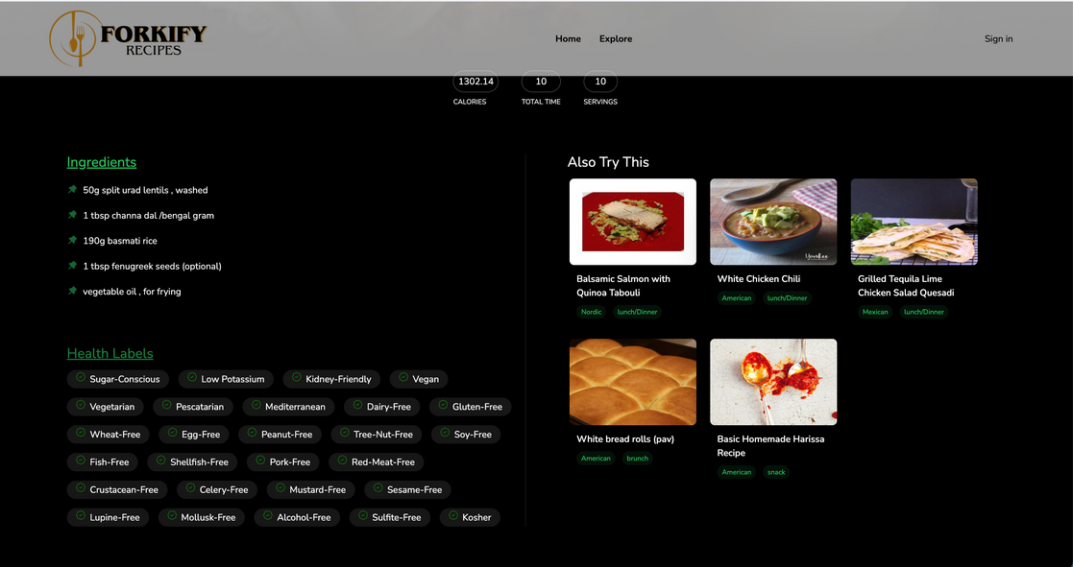


PROJECT HIGHLIGHTS
Ingredients and Health Labels shown of the recipe we searched

Slide 12


CONCLUSION
Forkify Recipes uses ReactJS and Tailwind CSS to create an engaging, user-friendly platform for culinary enthusiasts.
Real-time API integration provides comprehensive recipe details, including ingredients, calories, and preparation steps.
The component-based architecture ensures scalability and easy maintenance.

Slide 13

References /
Links Used
Udemy: https://www.udemy.com/
GitHub: https://github.com/
YouTube: https://www.youtube.com/

Slide 14

THANK YOU

